Slide 1
Analytics Assignment
Revati Deshpande
Role: Deployment Strategist at Peregrine
10/6/2024

Slide 2
Agenda
Problem Statement & Objectives
Data Description & Preprocessing
# Records, Features, Key Variables
Data transformation (handling missing values, encoding, scaling)
Exploratory Data Analysis
Methodology
Model Implementation
Results
Anomaly Distribution, Risk Scoring, Case Studies (Deep-dives)
Evaluation, Validation
Limitations
Conclusion & Recommendations

Slide 3
Executive Summary
?
Objectives
Insights
Comment#1:
Key Objectives | Metrics
Insight1
Insight2
Insight3
Insight4

Slide 4
Problem Statement & Objectives
Problem Statement:
01
Objective #1
02
Objective #2
03
Objective #3

Slide 5
Data Description & Preprocessing
Process |  | Supervised |  | Insights
 |  | Logistic Regression | Random Forest
Description (Raw dataset) | # Records | 78,600
 | # Features/Columns | 14
 | Target variable(s) Binary/Multiclass | Anomaly: this is the risk label for each transaction Multiclass as 3 values are present: ‘low_risk’, moderate_risk, ‘high_risk
Preprocessing | Handling Missing Values (dropping/imputing)
 | Dropping irrelevant columns
 | Encoding
 | Scaling
 | Feature(s) engineered
Description (Processed dataset) | # Records
 | # Features/Columns

Slide 6
Data Description & Preprocessing
Process |  | Unsupervised |  | Insights
 |  | Isolation Forest | Local Outlier Factor
Description (Raw dataset) | # Records | 78,600
 | # Features/Columns | 14
Preprocessing | Handling Missing Values (dropping/imputing)
 | Dropping irrelevant columns
 | Encoding
 | Scaling
 | Feature(s) engineered
Description (Processed dataset) | # Records
 | # Features/Columns
 | Added Features/Columns

Slide 7

Exploratory Data Analysis – Univariate Analysis Bar charts
Decile | Jun’23 | Jul’23 | Aug’23 | Sep’23 | Oct’23 | Nov’23 | Dec’23 | Jan’24
High | 718 | 185 | 7 | 15 | 12 | 12 | -19 | 38
Medium | 6.1K | 1.0K | 0.1K | 0.1K | 0.1K | 0.0K | -0.3K | 0.5K
Low | 34.0K | -1.7K | 0.3K | -0.1K | 0.4K | -0.1K | -0.1K | 0.3K
No Decile (0,-99) | 57.0K | 1.3K | 0.6K | 0.3K | 0.6K | -0.2K | -2.5K | 3.2K
Total | 97.8K | 98.6K | 99.6K | 99.9K | 101.0K | 100.8K | 97.9K | 101.9K
Insights
Insight 1
Insight 2
Insight 3
Footnote 1
Footnote 2
7

Slide 8
Exploratory Data Analysis – Multivariate Analysis Correl Heatmap
# Quarterly Calls (Calls/ HCP)
D4P TRx / HCP
PrEP Naïve / HCP
Q3’23
Q4’23
All other Targets
All other Targets
5.0K (2.2) | 29.0 | 3.4
5.3K (2.1) | 27.8 | 3.9
Targets (associated with called co-located HCPs):
720
Co-located HCPs Called: 434
Targets (associated with called co-located HCPs): 636
Co-located HCPs Called : 372
2.2K (3.1)
37.7
3.7
683 (1.6)
5.4
1.2
2.2K (3.5)
39.9
3.6
685 (1.8)
6.4
1.2
Called on
6.6K (1.7)
20.0
2.4
Not Called on
6.3K (1.7)
19.6
2.2
Targets (associated with not-called co-located HCPs): 3.8K
Co-located HCPs Not-Called: 13.9K
Targets (associated with not-called co-located HCPs):
3.8K
Co-located HCPs Not-Called: 14.1K
Data Source: IQVIA XPO (Jul’23-Dec'23); G360 (Jul’23-Dec'23); IQVIA XPD (Jul’23-Dec'23)
Q4'23 and Q3'23 target Lists are considered
Non-Target HCPs having PrEP TRx or have been Called in R12M (till Dec'23) have been considered for Co located HCP universe
8

Slide 9
Exploratory Data Analysis – Multivariate Analysis Scatter/Pair plots
Q3’23
CPD (Targets) – 5.5
# Working Days: 59
86% | 69% | 66% | 74%
% Reach
Q4’23
CPD (Targets) – 5.7
# Working Days⁷: 58
88% | 71% | 67% | 67%
% Reach
HCP Reached
444
521
667
3,254
1,869
Time Period – Sales on Q4’23 WE 12.29, Calls based on respective quarters.
Annualized Frequency based on Called HCPs in the bucket
Vacant Territories have been excluded from Actual Calls/HCP calculation
9

Slide 10
Exploratory Data Analysis - Multivariate Analysis Side-by-side Scatter/Pair plots
Q2’23 – Q4’23
Based on Targeting Summary from G-Target

Slide 11
EDA 4 – Comparison Boxplots
1
 | Q1’24 mBC Potential Contribution | % Contribution (R13W)
 |  | TRO Vials (867 data) | Enhertu ​Vials (DDD data – indication agnostic)
 | TRO Performance Projection (Actuals/ Goal) QTD | YTD | TRO Vials (867 data) | Enhertu ​Vials (DDD data)
East to Nation | 51% | 52% | 50%
Southeast to East | 19% | 20% | 19%
Miami | 24% | 34% | 29%
South Georgia | 15% | 19% | 18%
Jacksonville | 15% | 9% | 12%
Orlando | 19% | 18% | 17%
Tampa | 27% | 20% | 23%
R13W TRO growth in Southeast is at par with East and Nation, but R13W ENH growth is higher
Growth opportunity in Jacksonville and Tampa as TRO R13W sales contribution lags ENH and mBC potential contribution
Territory’s contribution to Region
1
2
2
Source: Trodelvy Sales - 867 data till Dec’23 ; Enhertu Sales - DDD data (indication agnostic) till Dec’23
R13W: 10/21 – 01/19, R8W: 11/25- 01/19, R4W: 12/23- 01/19
mBC Potential is calculated as per Q1’24 account segmentation

Slide 12
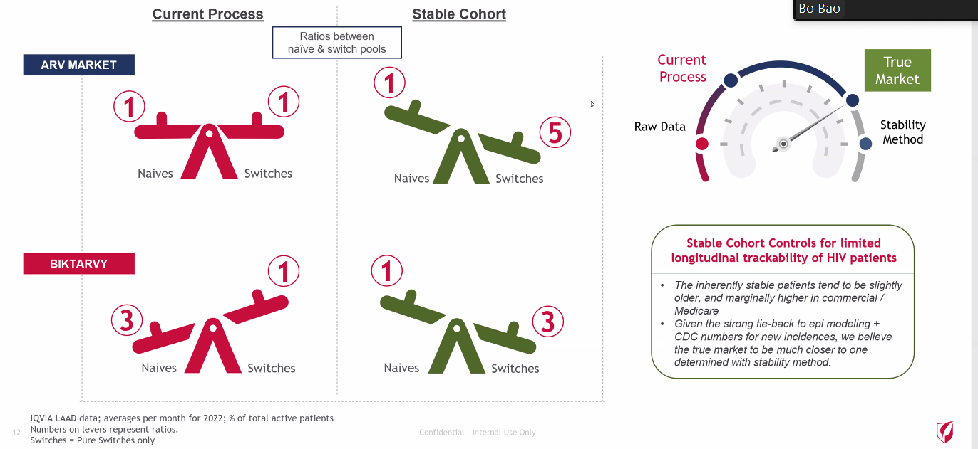

Slide 13
Methodology
We recommend xxx
Completed high-level testing on the data, taking yy as a directional metric to measure impact. Below are our recommendations to the business users:
Conduct thorough testing and impact analysis to ensure data and metrics meet requirements.
Retrofit processes as needed to align with updated data.
Assess impact of updated data.
 | Completed
 |  | In Progress
 |  |  |  |  | Pending
 |  |  |  |  |  |  | Pending

Slide 14
Model Implementation – Performance Assessment
Iteration | Classes | Model 1 |  |  |  |  | Model 2 |  |  |  |  | Insights
 |  | Accuracy | Precision | Recall | F1-score | Support | Accuracy | Precision | Recall | F1-score | Support
Iteration 1 | Low
 | Moderate
 | High
Iteration 2 | Low
 | Moderate
 | High
Insights
Insight 1

Slide 15
Model Implementation – Performance Assessment
Iteration | Classes | Model 1 |  |  |  |  | Model 2 |  |  |  |  | Insights
Iteration 1 | Low
 | Moderate
 | High
Iteration 2 | Low
 | Moderate
 | High
Insights
Insight 1

Slide 16
Results
Insights
Most influential features:
Feature importance
Business rules for classification:
BR1
BR2

Slide 17
Conclusion & Recommendations
Conclusion:
01
Recommendation 1
02
Recommendation 2
03
Recommendation 3

Slide 18
Thank You

